Slide 1
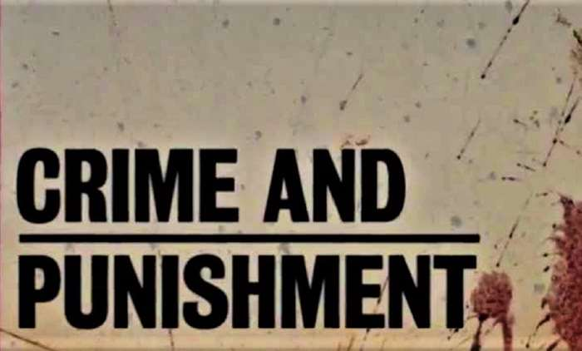
Epic Quiz!

Slide 2
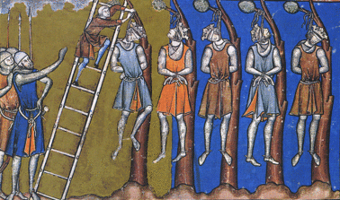
Medieval Crime and Punishment 1000-1500

Slide 3
1. How many men were in a tithing?

Slide 4
2. What was raised if someone saw a crime committed?

Slide 5
3. What happened if someone did not join this?

Slide 6
4. What was the first type of trial that a medieval criminal had to face?

Slide 7
5. What was the second trial called if the first could not reach a judgement?

Slide 8
6. What were the 4 eversions of this trial?

Slide 9
7. What was the name for the fines system used in Saxon times?

Slide 10
8. What was capital punishment?

Slide 11
9. What was the point of capital punishment?

Slide 12
10. What fine did William bring in for if a Norman was murdered?

Slide 13
11. What laws changed the definition of crimes so that chopping down trees and hunting deer were now crimes?

Slide 14
12. What trial did Normans introduce?

Slide 15
13. What could a criminal claim if they reached a church?

Slide 16
14. Why would a criminal prefer to be trialled in a Church Court?

Slide 17
15. When did Trial by Ordeal end?

Slide 18
10
Hue and cry
Whole village fined
Trial by jury
Trial by ordeal
Hot iron, hot water, cold water, blessed bread
Wergild
Execution
Deterrance, removal
Murdrum
Forest Laws
Trial by combat
Sanctuary
More lenient/no execution
1215

Slide 19
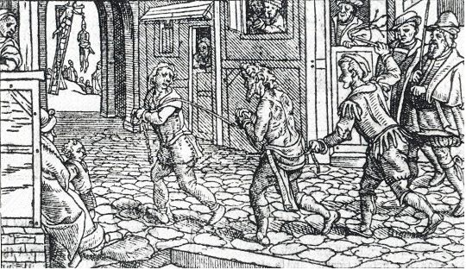
Early Modern Crime and Punishment 1500-1700

Slide 20
16. Which king made changes to the church in the 1530s?

Slide 21
17. What major event happened between 1642 and 1649 that made people feel like the world had turned upside down?

Slide 22
18. Which group were getting richer and wanted laws to protect their rights?

Slide 23
19. What had been invented in the 1500s that made it easier to tell people about crime?

Slide 24
20. Which group of terrorists tried to blow up James I in 1605?

Slide 25
21. What 2 crimes were they committing?

Slide 26
22. What crime was caused by the closing of the monasteries, disbanding on private armies and farmland being used for sheep?

Slide 27
23. Why were some people scared of these type of criminal?

Slide 28
24. What was the punishment for a first offence in 1598?

Slide 29
25. What were built from 1576 to house these criminals?

Slide 30
26. Who was the Witchfinder General?

Slide 31
27. Why was witchcraft now considered a crime when before it had been dealt with through the church?

Slide 32
28. Which King wrote a book about witches?

Slide 33
29. Who were employed to patrol town streets 1500-1700?

Slide 34
30. In 1688 the number of crimes carrying the death penalty increased. This was the start of the ________________?

Slide 35
Henry VIII
Civil war
Landowners
Printing Press
Gunpowder plotters
Heresy and treason
Vagabondage/vagrancy
Some were fake
Whipped and sent home
Houses of Correction
Matthew Hopkins
Religious changes put Henry VIII in charge of everything
James I
Watchmen
Bloody Code

Slide 36
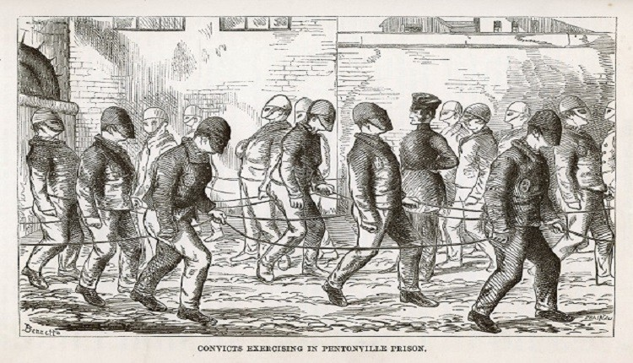
Industrial Crime and Punishment 1700-1900

Slide 37
31. What new crime developed because people were travelling more?

Slide 38
32. Give another reason why this became a crime?

Slide 39
33. What is a social crime?

Slide 40
34. What is the crime of hunting on someone else’s land?

Slide 41
35. Which act in 1723 made this a capital crime?

Slide 42
36. What was the crime of bringing goods into the country without paying import tax?

Slide 43
37. Name the gang of these criminals who used violence to hold on to their cargo?

Slide 44
38. Why did people commit this crime?

Slide 45
39. Which group were put on trial for swearing to keep their meeting secret?

Slide 46
40. What was their punishment?

Slide 47
41. Which brothers created the Bow Street Runners?

Slide 48
42. What did Robert Peel set up in 1829?

Slide 49
43. When did it become compulsory for all towns and counties to have these?

Slide 50
44. What was set up in 1878 to look at crimes?

Slide 51
45. What were the 3 reasons for the end of the Bloody Code in the 1820s and 1830s?

Slide 52
46. Where were criminals sent as a punishment after the 1770s?

Slide 53
47. What was the name for the prison ships?

Slide 54
48. What happened in 1851 that made transportation attractive?

Slide 55
49. How were criminals organised in the old prison system?

Slide 56
50. Name the 3 prison reformers who wanted the old system changed.

Slide 57
51. Which prison was built as a model for others using the separate system?

Slide 58
52. What was introduced in the 1860s to make prison life even harder for criminals?

Slide 59
53. Prisoners had to turn the ________________ up to 10,000 a day.

Slide 60
54. The 3 principles of this system were: Hard _______, Hard _______ and Hard _______?

Slide 61
55. What was the point of these types of prison system?

Slide 62
Highway robbery
No police, Goods sold in taverns, lonely areas out of town
A crime many do not view as a crime as they benefit
Poaching
Black Act
Smuggling
Hawkhurst Gang
Money
Tolpuddle Martyrs
Transportation
Fielding Brothers
Metropolitan Police
1856
CID
Juries wouldn’t convict, public executions not working, changing attitudes
Australia
Hulks
Gold discovered
All mixed up
Robert Peel, John Howard, Elizabeth Fry
Pentonville
Silent system
Crank handle
Fare, labour, board
Deterrance

Slide 63
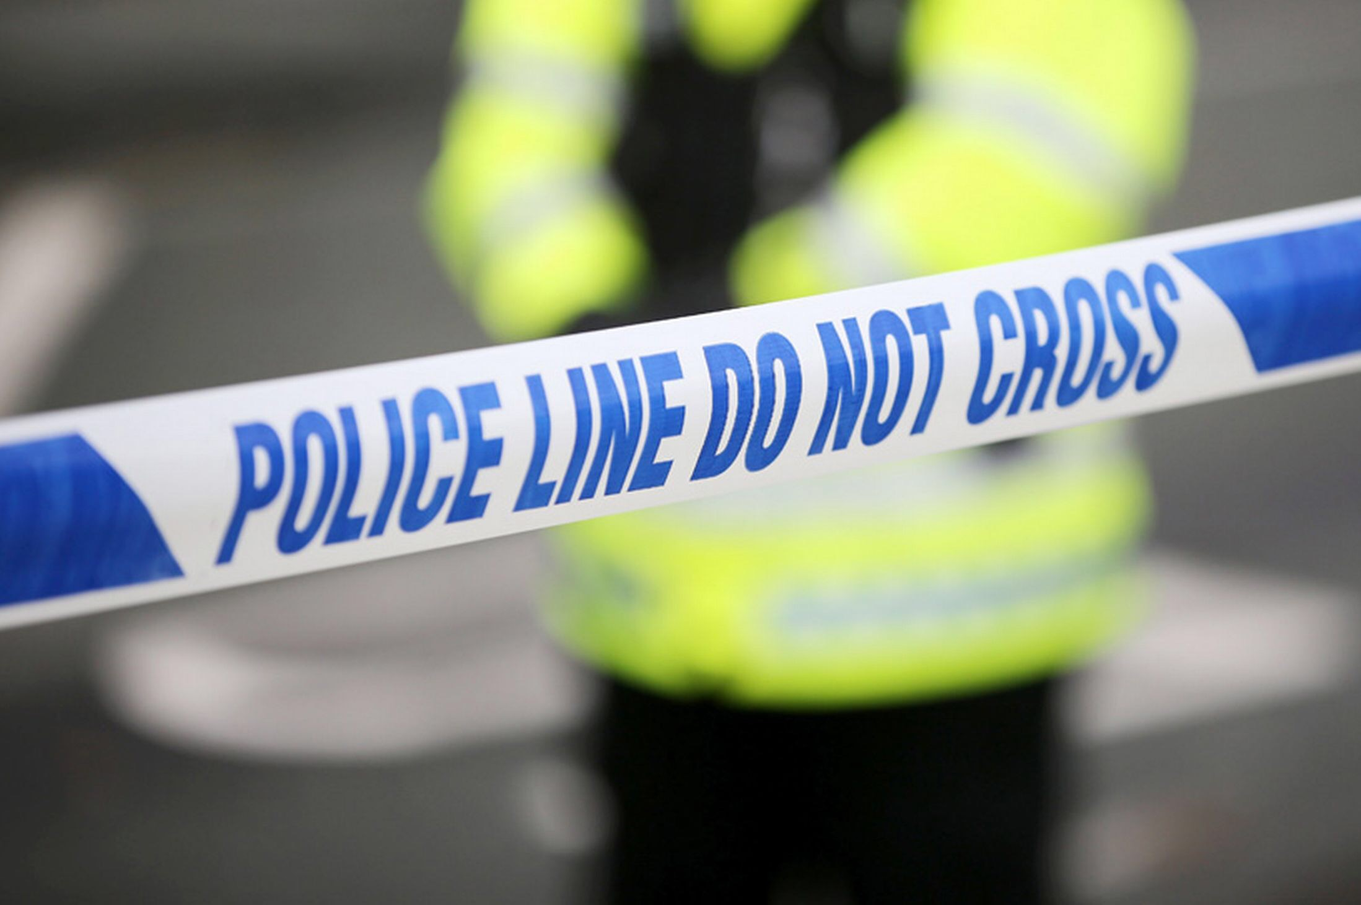
Modern Crime and Punishment 1900-present day.

Slide 64
56. Give 2 examples of what is smuggled in modern times.

Slide 65
57. What was the name for the people who refused to fight in the World Wars?

Slide 66
58. Since 1947, how many weeks of basic training do police have to do?

Slide 67
59. What new development lead to a murder conviction in 1988?

Slide 68
60. What were introduce in the 1930s to help police communication?

Slide 69
61. What major change came to prisons in 1922? (Something was ended)

Slide 70
62. The first what type of prison was built in 1933?

Slide 71
63. What is the main focus of modern prisons?

Slide 72
64. What is a non-custodial sentence?

Slide 73
65. Give an example of a modern, non-custodial punishment.

Slide 74
66. What were introduced as a juvenile version of prison in 1902 but abolished in 1982?

Slide 75
67.Who was hanged in 1953 for the murder of a policeman?

Slide 76
68. Who was the last woman to be hanged in 1956?

Slide 77
69. When was capital punishment abolished?

Slide 78
70. Which factor played the biggest part in ending the death penalty?

Slide 79
Drugs, people, weapons
Conscientious Objectors
14
DNA
2 way radios
No more solitary confinement
Open prison
Reform/rehabilitation
Not in prison
ABC, curfew, tagging
Borstals
Derek Bentley
Ruth Ellis
1965
Changing attitudes

Slide 80
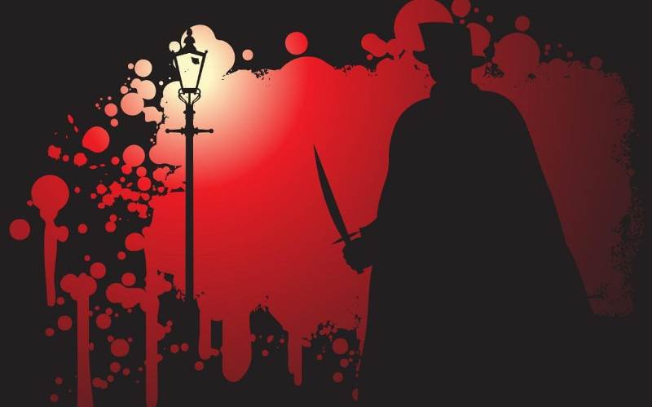
Crime and Punishment: Whitechapel 1870-1900

Slide 81
71. What was the name given to an area filled with overcrowded lodging houses for the poor?

Slide 82
72. Give the names of 2 of these areas.

Slide 83
73. Who wrote a report on poverty in London?

Slide 84
74. Where did people go who couldn’t afford a room or were too young, old or unwell to work?

Slide 85
75. What happened to families in these places?

Slide 86
76. What was oakum picking?

Slide 87
77. Which group came to Whitechapel but found it hard to integrate and so ended up segregated?

Slide 88
78. What was often a factor in arrests for ‘disorderly behaviour’?

Slide 89
79. Who was appointed Police Commissioner in 1870?

Slide 90
80. Who replaced him in 1886?

Slide 91
81. Which police division covered Whitechapel?

Slide 92
82. What was the name for the area that a policeman had to patrol?

Slide 93
83. What was a problem with this?

Slide 94
84. Complete the list of difficulties the police had to deal with in Whitechapel:
Alcohol, gangs, ___________ and __________________.

Slide 95
85. Who began a series of murders on 31st August 1888?

Slide 96
86. How many definite victims were there?

Slide 97
87. What new technology was used by the City of London Police to document the crime scenes?

Slide 98
88. Why did Lusk set up the Whitechapel Vigilance Committee?

Slide 99
89. What body part was sent to Lusk?

Slide 100
90. How did the press hinder the Ripper investigation?

Slide 101
Rookery
Flower and Dean Street, Peabody estate
Charles Booth
Workhouse
Split up
Picking rope apart
Jewish
Alcohol
Edmund Henderson
Charles Warren
H Division
The beat
Criminals would know the route
Prostitution, immigration
Jack the Ripper
5
Photography
Police not doing enough
Kidney (1/2)
Sensationalised stories, mocked police.

