Slide 1
Economic
Political
Impact of WWI on Germany
Social
What was the German Revolution?

Slide 2
Terms of the TOV
Treaty of Versailles
Reaction in Germany/effects on the country:
-

Slide 3
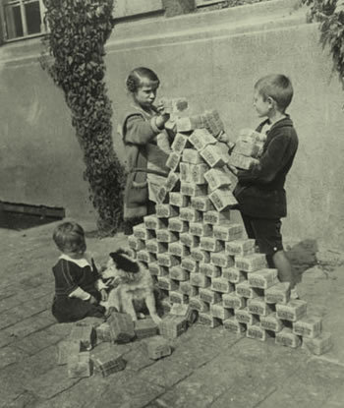
Proportional Representation
Article 48
Spartacist Uprising
Left-wing rebellions
Ineffective Constitution
Why did the Weimar Republic face problems 1918-23
Hyperinflation 1923
Right Wing Extremism
Hatred of the Treaty of Versailles and ‘November Criminals’
Kapp Putsch

Slide 4
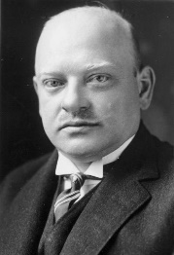
Dawes Plan
Foreign Affairs
Art and Culture
Recovery of the Weimar Republic (summer homework) 1924-29
Stresemann's reforms
Economic Growth
Inflation controlled 1923
French leave Ruhr

Slide 5
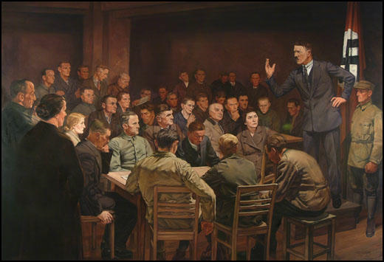
What was it?
Why did it fail?
Munich Putsch
Hitler’s time in Prison and Mein Kampf
Consequences
How did Hitler change tactics after this?
Was it a turning point?

Slide 6
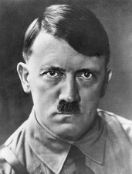
Speeches
Propaganda
25 Point Programme
Administrator
Personal appeal of Hitler
Party Organisation
Logo
How did Hitler reform the Nazi Party?
Party Leadership
SA/Brownshirts

Slide 7
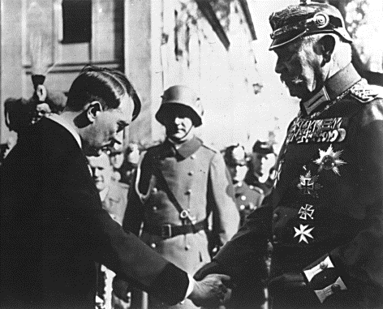
Role of Hitler – speeches, propaganda, charisma
Role of Schleicher, Von Papen and Hindenburg
How did Hitler grow in support and become Chancellor?
Wall Street Crash 1929
Promises Hitler made to different groups of people

Slide 8
Reichstag Fire
Death of Hindenburg
How did Hitler become Dictator?
Enabling Act
Knight of Long Knives

Slide 9
The Confessing Church 1934
Edleweiss Pirates
Pastors’ Emergency League (PEL)
Swing Youth
Opposition to Nazi state
Church
Young people
Catholic priests
Pastor Martin Niemoller
White Rose

Slide 10
Controlling judges
Controlling legal system
Legal System
Controlling religious views
Police State – crushing opposition
SS (Hitler’s personal bodyguard)
Gestapo
SD
Concentration camps

Slide 11
Why were young people important?
Curriculum/schools
Young People
Activities at Hitler Youth for Boys
Activities at League of German Girls for girls

Slide 12
Youth policies
Evidence of success | Evidence of failure
 | e.g. – opposition groups/why it was unpopular

Slide 13
Nazi Views of women and family
Policies to encourage marriage
Women
Policies to do with banning women from employment
Policies to encourage women to have children

Slide 14
Anti-Jewish Laws:
Eugenics
Racial hygiene
Nazi beliefs about race
Hitler’s views
Slavs
Minorities
Gypsies
Treatment of minorities
Anti-Semitism and policies towards Jewish people
Kristallnacht 1938 and the reaction of ordinary people
Homosexuals
Disabilities

Slide 15
Why was Catholic Church
a threat to Hitler?
The Reich Church, 1936
Policies towards Protestant Church
Policies towards Catholic Church
Church in Nazi Germany
Evidence Nazis worked with Catholic Church | Evidence Nazis worked to destroy Catholic Church
Concordat with Pope, July 1933
Opposition from the church

Slide 16
Wages and hours worked
Employment rates
Autobahns
Labour Service (RAD)
Changes in standard of living
Invisible unemployment
Employment in Nazi Germany
Nazi Policies to reduce unemployment
Beauty of Labour (SdA)
Rearmament
Nazi organisations
Labour Front (DAF)
Strength through Joy (KdF)

